Slide 1
Read Me: This deck contains two sections. One for participants and a second for coaches.
Participant section
This top section is a Tech Scenario description for participants. The section will cover the technology introduction and high-level concepts about the challenges.
Audience: Participants at OpenHack
Coach only section
This section is a Tech Scenario description for coaches. The section will cover the technology, challenge goals, common pit falls, general guidance on solutions. This section is presented to coaches in the ‘know before you go’ call a few days before the OpenHack starts. This section is intended to be more in-depth than the participant section. Do not share the coach section with participants!
Audience: Coaches at OpenHack
Section 1
Section 2

Slide 2

Microsoft Azure Well-Architected Framework
#MSOpenHack

Slide 3
Microsoft Azure Well-Architected Framework
Technologies
Azure DevOps
Azure Bicep/ARM Templates
Azure Key Vault
Azure Traffic Manager
Azure Virtual Machines
Azure App Service
Azure SQL
Azure Load Balancer
Azure Application Gateway – WAF v2
Azure Cost Management
Azure vNets
Azure Private Endpoints
Azure Monitor
Azure Defender
Azure Sentinel
Grafana
Become familiar with the benefits and the scope of the Microsoft Azure Well-Architected Framework’s pillars: cost optimization, operational excellence, performance efficiency, reliability, security.
Apply the Microsoft Azure Well-Architected Framework to a workload using the ACHIEVE method: assess, consider, hypothesize, improve, validate
Effectively communicate the Microsoft Azure Well-Architected Framework and become equipped for delivering assessments for the Microsoft Azure Well-Architected Framework and Go-Live.

Slide 4
Microsoft Azure Well-Architected Framework Success Factors

Slide 5
Shared understanding
The Microsoft Azure Well-Architected Framework OpenHack is L400+. In other words, it is much more difficult than your previous OpenHacks. Your technical depth will be stretched.
Your team should be comprised of experts in their respective field of infrastructure, application development, DevOps, data, or security. This OpenHack is not recommended for architects who are intermediate or below in their focus area.
There is a difference between assessments and implementation. While much of this OpenHack has teams implementing solutions, it is understood that your role may be to only conduct assessments and provide direction. However, we feel it is important to know the intent behind the questions of the Microsoft Azure Well-Architected Framework and Go-Live assessments so that you can coach and advise accordingly.
This OpenHack prepares you for both live workloads (WAF) and proposed architectures for greenfield workloads (Go-Live). Each challenge is designed to upskill you across multiple areas within all five pillars. It is our intent that you recognize the cross-effects of each pillar regardless of which assessment you deliver.
You are not expected to be an expert at everything. Instead, leverage your teammates and glean as much as you can from them.

Slide 6
Success Tips
Pay attention to the time expectation for each challenge and govern yourselves accordingly.
Every challenge has a “Success Tips” section. These tips are designed as guideposts to lead you toward the right direction.
Leverage your coach as much as possible. Your coach is expected to be available at all times.
Additionally, continuously solicit feedback from your coach. The coaches are not expected to give answers, but they are here to ensure you continue to move through each challenge efficiently.
Attendees on high DPI Windows devices such as Surface Books may wish to consider installing mRemoteNG to mitigate DPI scaling issues in the native Windows RDP client (note that this is not a requirement for this OpenHack, simply a lifehack)
Attendees should not only read the overview, but also
Login to their Azure subscription and explore the resources that are deployed
Login to their Azure DevOps tenant to ensure all repositories are there
Attendees should be very aware that they are working with a "production" environment before they get hands on keyboard

Slide 7





ACHIEVE method
This OpenHack encourages participants to execute the ACHIEVE method when evaluating the workload under the lens of the Microsoft Azure Well-Architected Framework.
Assess
Consider
Hypothesize
Improve
Validate
Assess current workload
Document components and configurations
Document gaps and concerns
Greater detail increases chances for success
Be aware of too much detail and where depreciating value begins
Review assessment
Consider how each WAF pillar applies to each component identified
Conversely, consider how each component identified affects each WAF pillar
Propose new ideas to improve each component
Consider how proposed solutions affect—positively or negatively—the component under the lenses of WAF
Remember, the smallest solutions can still have tremendous impact
Begin implementing improvements
Don’t try to “boil the ocean”—gradually introduce changes
Validate results
Determine how results affected each pillar and all pillars, collectively, of WAF
Did ”improvements” create positive or negative results?
Weigh outcomes and allow customer to determine business priority (e.g., cost vs. performance)

Slide 8
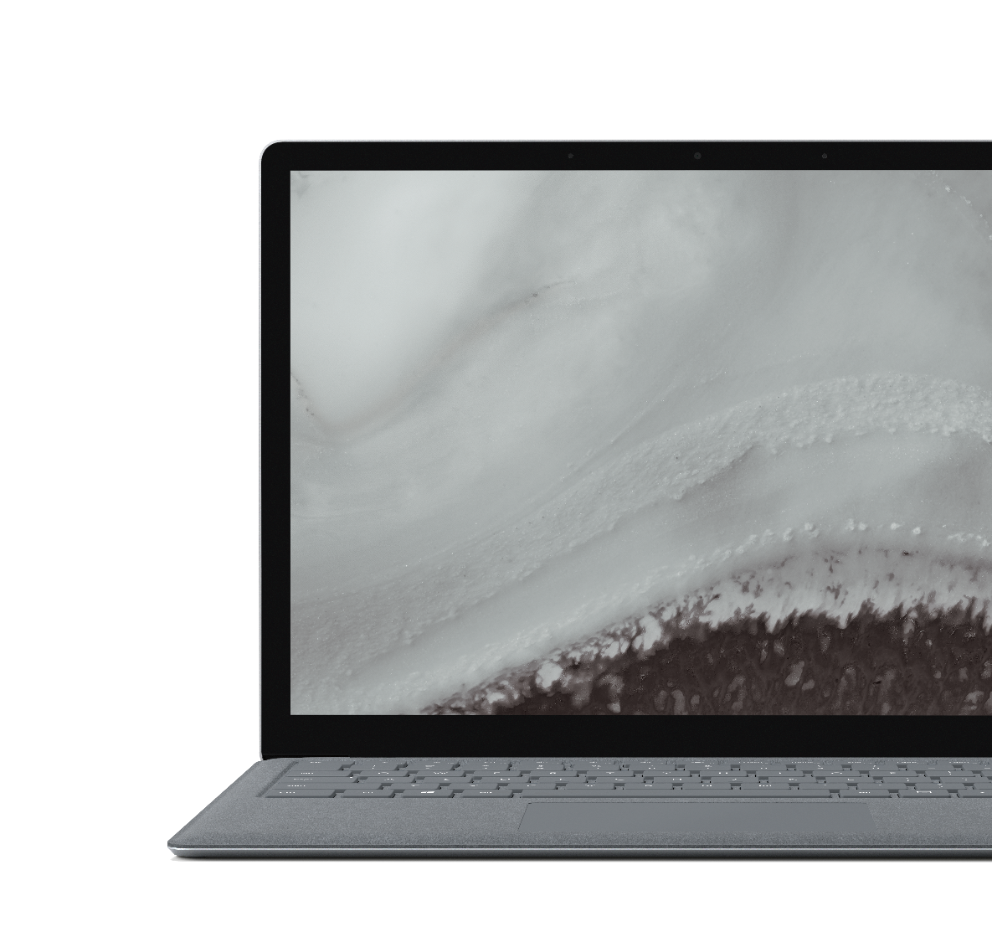
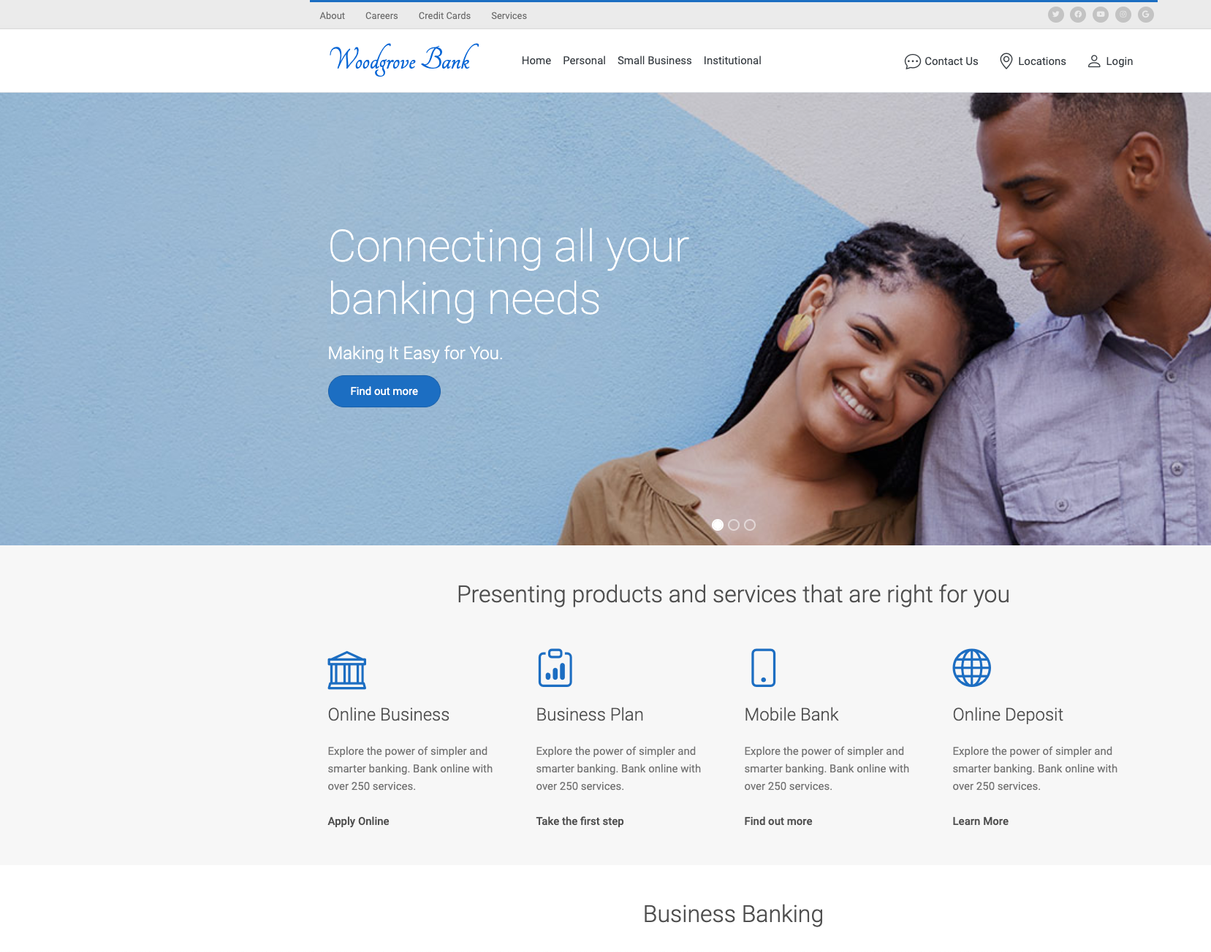
Scenario
Woodgrove Bank
Adopting Azure and moving on-premises applications from data centers.
Woodgrove Bank is strictly Microsoft for application development.
The web application is currently used by customers to check account balances.
Background, nightly service job processes posted transactions.
The mission is to evaluate current workload, then plan and implement WAF principles.
The success of team depends on their ability to not only execute a challenge, but also provide enough reasoning for the choices they make.
Notes:
During the OpenHack, your team will evaluate Woodgrove Bank’s initial attempt to move an application into Azure.
The legacy application is in the middle of a re-architecture for the purposes of leveraging a microservice approach. Woodgrove Bank has reached their limit in knowledge and is reaching out to Microsoft for next steps.
While working through this OpenHack, your team will practice evaluating workloads through lenses of the 5 WAF pillars. You will then make recommendations and provide instruction to Woodgrove Bank as your transform their IaaS workload. Once the workload is WAF-optimized, you will then modernize the workload by transitioning it to PaaS, where applicable.
Throughout all challenges, you must maintain rigorous attention to the core principles of each WAF pillar.
Any resemblance to actual scenarios, issues, or pain points that you are facing is not purely coincidental. The definitions of the challenges that will be presented to you during this event are inspired by real life.

Slide 9
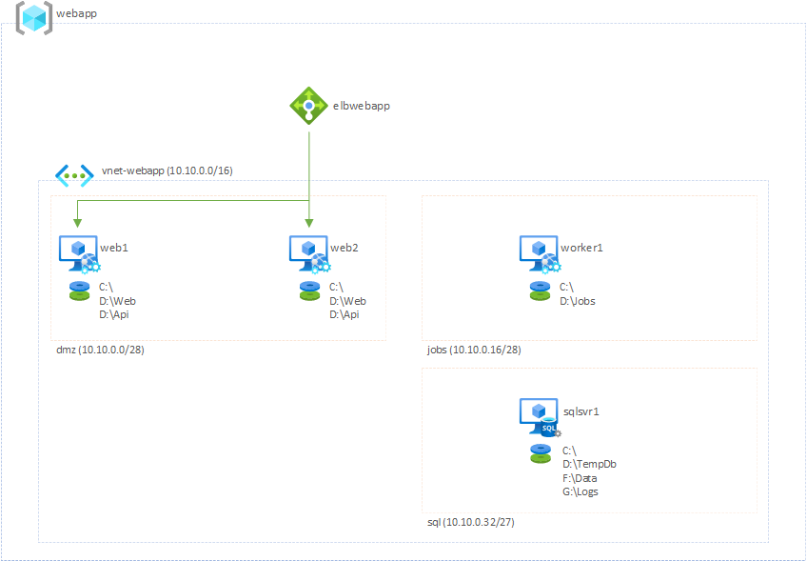
Architecture - Infrastructure
1 resource group
1 external load balancer
1 vnet
3 subnets
dmz
jobs
sql
4 vms
2 web servers
1 background service server
1 sql server

Slide 10
Architecture – Application
Customer Portal
Frontend – Razor Pages
Backend – WebAPI
Background Service
Console App (Timer Job)
Database
SQL Server 2014 SP3
* Razor Pages and WebAPI both exist on the same web server, but two different web applications in IIS

Slide 11
Challenge 1 Assess the environment

Slide 12
Challenge 1 overview
Time Length: 4-5 hours
In this challenge, you will assess a customer's production environment that has been deployed to Azure and currently hosting a live workload. You will gain an understanding of the customer's current process for deployment and management of the applications and supporting cloud resources. Part of this understanding will include performing a cost analysis of the Azure environment and establishing some baseline performance metrics. Based upon the assessment, you will need to craft a plan to assist the customer in adoption and implementation of the Microsoft Well-Architected Framework. You will use this plan to govern how you proceed in future challenges.

Slide 13
Challenge 1 objectives
Time Length: 4-5 hours
Inventory current components
Identify potential areas of improvement
Perform a cost analysis of the environment
Conduct an initial performance test
Conduct a load test against current business SLAs
Conduct a stress test
Establish and document performance baselines
Understand the difference between the three types of performance tests
Demonstrate a basic understanding of WAF
Document any initial concerns for business meeting SLAs

Slide 14
Challenge 1 success tips
Time Length: 4-5 hours
Identify the various roles within your team. Delegate responsibilities to different members and allow each other to cross-train the team. You all are facilitators of learning.
Members should attempt to work on success criteria in parallel, where applicable.
Leverage your coach as much as necessary. Do not allow yourself to get stuck—it will greatly affect your time.
The customer workload has many deficiencies across all pillars of WAF. Don’t get caught in the ”rabbit hole” by trying to identify everything. Consider the 80/20 rule: focus on the 80% that will deliver the most value initially, then the remaining 20% can be tackled over time.
Use a shared document (e.g., Word, OneNote, etc.) for collecting identified components. This is not something you will “present” to the customer (or coach), and therefore will not need to be “pretty.” Instead, this is a “task list” for you to refer to throughout the remaining challenges.
NOTE: There is a sample document (Architecture_Assessment.docx) in the participant’s portal that can be a good starting point for collecting components and issues within the customer’s environment. Using this document is not required but could help accelerating your efforts.

Slide 15
Challenge 1 success tips
Time Length: 4-5 hours
Ensure that business SLAs are always considered while you assess the environment.
Don’t attempt to re-invent the wheel—use resources that have already been created.
A sample, performance test script (k6) has already been created. Simply update the URLs, stages, and thresholds. It is more important that you learn what the data means versus you attempting to write performance test plans from scratch.
Pay attention to customer’s requirements regarding costs: reporting, budgeting, charge-backs, etc.

Slide 16
Challenge 2 Operationalize automated deployments

Slide 17
Challenge 2 overview
Time Length: 3-4 hours
In this challenge, you will assist the customer in adopting automated deployments of both the application and infrastructure. You will explore the Azure Bicep scripts included in the Azure DevOps project and learn how to convert them to ARM templates for environment configuration and deployments. When helping the customer automate infrastructure and application changes, you will configure build and release pipelines. You will also attach deployment gates to release pipelines for security and governance of cloud resources. Deployments should ensure that only the correct resources should be removed by reporting changes prior to being executed. It is important that you have a firm understanding of Azure Bicep and that your pipelines are configured correctly as all future changes to the Azure environment must be conducted through the pipelines.

Slide 18
Challenge 2 objectives
Time Length: 3-4 hours
Create build/release pipelines in Azure DevOps
Determine best strategy for deployments (conditions, types, etc.)
Demonstrate "what-if" scenarios with deployments
Configure gated deployments
Discuss deployment models to maximize uptime

Slide 19
Challenge 2 success tips
Time Length: 3-4 hours
There are yaml-based build scripts included with each of the three repos. They currently build the assets and place them in a drop folder. The goal of this challenge is not crafting original build scripts, but to leverage the existing build scripts and configure build/release pipelines.
VMs will need to be added to deployment groups. Make sure you are aware of how to install the agents.
Don’t be afraid to whiteboard various processes to determine the best approach.
Rollbacks don’t necessarily always mean rolling back code deployments. There are other methodologies for rolling back features and enhancements. Your team should consider and discuss pros/cons of various methodologies.

Slide 20
Challenge 2 tech tips
Time Length: 3-4 hours
In the network.bicep file, there are some undocumented REST properties which will create warnings when building the Azure Bicep definition. You can ignore these warnings.
If your team is not familiar with Azure Bicep and feels more comfortable working with standard ARM Templates, it is acceptable to build the Azure Bicep definition locally, then leverage the ARM template for your deployments going forward. The goal is not to necessarily learn Azure Bicep, but to become familiar with infrastructure as code (IaC) and automated deployments. (Using Terraform is also acceptable but doing so may be a waste of valuable time.)
When testing deployments with what-if, you will receive a series of false-positives for changes in the external load balancer’s backend pools. This is a documented bug in the ELB’s REST API.

Slide 21
Challenge 3 Planning for failure

Slide 22
Challenge 3 overview
Time Length: 4-5 hours
It is not a matter of if an environment will fail, but when. Therefore, prior to any changes being introduced into the application or its supporting infrastructure, it is important that proper monitoring and alerting be configured. In this challenge, you will determine what types of monitoring, along with the necessary data points, should be conducted. You will also determine and configure any necessary alerting of activities within your environment. These activities could include, but are not limited to, resource availability (or lack thereof), security threats, etc. Finally, you will determine a BCDR strategy in which you will implement in a future challenge.

Slide 23
Challenge 3 objectives
Time Length: 4-5 hours
Inventory current components
Discuss potential alerting options and processes
Compose a list of metrics that should be monitored
Compose a list of conditions that should generate an alert
Configure alerting for determined conditions
Demonstrate a successful alert
Configure Azure Monitor and Security Center
Enable Azure Sentinel
Discuss BCDR strategy, including the varying costs of potential solutions relative to RPO/RTO/SLAs/KPIs
Document BCDR strategy
Identify points (roles) of contact for failures in the environment and construct a RACI chart

Slide 24
Challenge 3 success tips
Time Length: 4-5 hours
Some of the implementation “to-do’s” of this challenge can be quickly delegated to individual team members and can be accomplished quite quickly and in parallel.
Leverage the list of components you identified in Challenge 1 and determine what types of alerts can be created and identify the conditions that generate those alerts.
Additionally, identify important metrics that should be monitored for each component.
This is a document-heavy challenge. Don’t attempt to “shortcut” the process.
Consider Woodgrove Bank’s industry and their compliance requirements. How does that affect log storage?

Slide 25
Challenge 3 success tips
Time Length: 4-5 hours
Ensure everyone knows what a RACI chart is and its importance in determining response for technical conditions that have critical business impact.
Create a shared document for your BCDR and RACI documentation. Then, identify important sections/technologies/etc. Finally, attempt to take a paired approach to completing these documents where groups are responsible for completing sections and reviewing others’ work.

Slide 26
Challenge 4 Visualizing Operations

Slide 27
Challenge 4 overview
Time Length: 2-3 hours
Now that significant planning and documentation has been completed, it is time to begin executing those plans. However, one last thing to consider is visualizing changes across your environment. In this short challenge, you will take the composed list of metrics and conditions from the last challenge and build some operational dashboards. You will create a free Grafana account and link your Azure Monitor instance to it. You will then build some time-series reports and create an operational dashboard.

Slide 28
Challenge 4 objectives
Time Length: 2-3 hours
Creating demo Grafana account
Linking Azure Monitor to Grafana
Creating operational dashboard in Grafana
Reporting on IaaS resources
Discuss the benefits and use cases of a real-time operational dashboard

Slide 29
Challenge 4 success tips
Time Length: 2-3 hours
Leverage the metrics you listed in the previous challenge.
Before jumping into Grafana, construct a quick and simple Azure Metrics dashboard. This can help align the team (and the customer) on what is being presented along with validating the approach.
Consider the variations in views between different teams. Multiple teams could be interested in monitoring the same component, but different metrics for that component.

Slide 30
Challenge 5 Improve the environment

Slide 31
Challenge 5 overview
Time Length: 3-4 hours
Before any changes are introduced into the current application architecture, the customer is interested in hardening what is currently deployed in terms of security, redundancy, and overall optimization. In this challenge, you will leave the application structure as-is—leaving it running on VMs—but you will implement some changes to the deployments and configurations of the environment. You will need to address secrets, potential areas of attack, and resiliency within the application. You will also need to make sure the telemetry is captured from the application and the virtual machine.

Slide 32
Challenge 5 objectives
Time Length: 3-4 hours
Right-sizing VMs
Redundancy of VMs using Availability Zones and proper storage configurations
Securing network resources using NSGs
Implementing JIT on VMs
Discuss and properly configure RBAC based on RACI matrix
Discuss options for securing database connection strings and implement a solution
Adding Application Insights to an application
Configuring VM to send telemetry via Application Insights or Log Analytics agent
Replacing ELB with Application Gateway and configuring OWASP
Comparing performance to baselines and ensuring that business SLAs are met with changes in architecture
Discuss potential cost improvements

Slide 33
Challenge 5 success tips
Time Length: 3-4 hours
Leverage the list you created in Challenge 1. It will help serve as a guidepost for possible improvements.
At this point, all infrastructure-focused team members should be familiar with Azure Bicep. Ideally, all team members should know how to use Azure Bicep. Implementation will require many hands-on contributors.
Strategically determine which changes you will make and how you will make them. Ideally, you would make small changes in a Staging environment and test often. However, given the time constraints of this OpenHack and re-deploying the infrastructure can take 15-20 minutes, you may not have that option. Therefore, make appropriate changes in stages (probably 4-6 stages) and test the performance of those stages.
Prior to making any changes, discuss the pros and cons of those changes with your team and coach to determine the best route.
Non-infrastructure team members may focus on updating Azure DevOps pipelines and Grafana dashboards, as necessary.

Slide 34
Challenge 6 Leveraging PaaS services

Slide 35
Challenge 6 overview
Time Length: 3-4 hours
Often, customers choose to build their own environments for services already managed by Microsoft or its partners. This customer is no different. In this challenge, you will begin migrating the components of the web application to Azure's various PaaS offerings. As you migrate the application and configure its services, you must consider all pillars of the Microsoft Well-Architected Framework. With your implementation, you will need to ensure that all of the customer's SLAs are able to be met at all times while maintaining adherence to the Microsoft Azure Well-Architected Framework. You will also need to make sure that your Grafana dashboards are updated to report desired metrics from the new resources. Finally, all alerts should be updated based on the new resources.

Slide 36
Challenge 6 objectives
Time Length: 3-4 hours
Configuring Azure App Service for autoscale
Securing Azure App Service
Configuring Azure SQL for failover
Using Key Vault in Azure App Service
Enabling SQL Always Encrypted
Leveraging private endpoints
Using Azure Batch
Continue comparing performance to baselines and ensuring that SLAs are met with changes in architecture
Failing a region while maintaining performance SLAs
Reporting on PaaS services

Slide 37
Challenge 6 success tips
Time Length: 4-5 hours
As with other challenges, it may be best to discuss with the team first, then delegate responsibilities. Much of the work can be accomplished in parallel.
The application must remain operational during the transition. Can the application be migrated in stages? Can it run simultaneously on IaaS and PaaS?
Determine the best way to predict scale and resulting costs when deploying (or migrating) a workload to PaaS.
Security strategies for IaaS and PaaS are similar in some areas, different in others. What ways are they similar? What ways are they different? Make sure any PaaS solution that you introduce is highly secured. This includes the infrastructure and application components.
Determine the changes that you will need to make to automate the deployments of the infrastructure and the application.

Slide 38
Challenge 6 success tips
Time Length: 4-5 hours
To maintain performance, think about proactive scale configurations. How can you scale the application proactively to maintain performance without sacrificing costs (too much)? Also, remember to configure “scale in” settings.
For dashboards, start by attempting to “translate” the performance counters you were reporting for IaaS to PaaS. Which performance counters can be re-used (just updating the resource in Grafana from VM to App Service)? Where performance counters need to be dropped, or are no longer available? What additional data is available from PaaS services that was not available with IaaS?

Slide 39
Challenge 7 Optimizing the API

Slide 40
Challenge 7 overview
Time Length: 2-3 hours
In the previous challenge, you may have elected to move the API to Azure Functions. If so, great! If not, here is your chance. In this challenge, you will separate the web front-end (WFE) from its services layer (API). Upon doing so, you will move the service layer to Azure Functions. In light of the Microsoft Azure Well-Architected Framework, you will also need to configure Azure Functions accordingly.

Slide 41
Challenge 7 objectives
Time Length: 2-3 hours
Separating an application's front-end from its API
Securing of Azure Functions
Configuring autoscaling of Azure Functions
Instrumenting Azure Functions with Application Insights
Discuss the various billing models of Azure Functions and the reasoning behind which one was chosen in the case of this challenge
Discuss the benefits of separating the two layers of the application
Continuing to compare performance to baselines and ensuring that business SLAs are met with introduction of Azure Functions

Slide 42
Challenge 7 success tips
Time Length: 2-3 hours
This challenge will primarily involve some application refactoring. You will need to move the current API endpoints to Azure Functions.
Perhaps the easiest thing to do is, first, identify the current endpoints. Then, determine how they will be arranged in the Azure Functions. Finally, copy and paste the API code to its respective HTTP Trigger function.
It could be very easy to attempt to over-architect this solution. Resist the urge. Remember, you (or Woodgrove Bank) can also add additional architecture later. What is the minimum configuration necessary to secure and optimize the API?

Slide 43
Challenge 8 Tightening database security

Slide 44
Challenge 8 overview
Time Length: 1 hour
The application, unfortunately, is still using legacy database connection strings. This means that there are still identities (SQL or Azure AD) that are used to connect the application to the database. In this challenge, you will refactor your application to leverage managed identities for database connectivity and remove application-specific named users from the database.

Slide 45
Challenge 8 objectives
Time Length: 1 hour
Using managed identities for database connectivity
Understand and discuss the benefits of managed identities in terms of the Microsoft Azure Well-Architected Framework
Enabling data encryption in transit and at rest.

Slide 46
Challenge 8 success tips
Time Length: 1 hour
Don’t try to overcomplicate things and do more work than necessary. This challenge is pretty straightforward and should not take you long to complete.
Make sure you have configured an AD-based database administrator. This is required prior to using any type of AD-managed identity for connectivity.

Slide 47
Challenge 9 Capturing correlation data

Slide 48
Challenge 9 overview
Time Length: 1-2 hours
You have already introduced Application Insights into your application. However, the customer is finding it difficult to correlate errors between the web front-end and the backend. In this challenge, you will discuss approaches to implementing the capturing of correlation data when an error occurs in the application. Remember, solutions should consider all pillars of the Microsoft Azure Well-Architected Framework.

Slide 49
Challenge 9 objectives
Time Length: 1-2 hours
Discuss techniques for capturing correlation data
Understand costs and security when storing correlation data
Understand how processing correlation data can impact application performance
Understand what data to capture in a distributed architecture

Slide 50
Challenge 9 success tips
Time Length: 1-2 hours
Make sure you read the included references. They can help tremendously with determining a solid strategy.
Ensure you store the right amount of data. Too little data provides very little insight for bug remediation; too much data can slow down application performance and increase costs. Find the right mix.
Make sure you are not storing any type of PII. Your strategy, however, will need to include a way to correlate captured issues with the user(s) who experienced them.
Determine how you will ensure that the same bug isn’t encountered in a future regression.

Slide 51
Challenge 9 success tips
Time Length: 1-2 hours
To maintain performance, think about proactive scale configurations. How can you scale the application proactively to maintain performance without sacrificing costs (too much)? Also, remember to configure “scale in” settings.
For dashboards, start by attempting to “translate” the performance counters you were reporting for IaaS to PaaS. Which performance counters can be re-used (just updating the resource in Grafana from VM to App Service)? Where performance counters need to be dropped, or are no longer available? What additional data is available from PaaS services that was not available with IaaS?

Slide 52
Feedback
Goal-Oriented – It states what is trying to be accomplished by the user
Specific – Gives details about the scenario, observations, and/or challenges faced by the user
Actionable – Provide necessary clarifying information to enable a decision

Slide 53

Let’s get started!
aka.ms/OHPortal
Login with the credentials supplied to your team.
Notes:
To get started, visit the OpenHack portal:

Slide 54
Microsoft Azure Well-Architected Framework
Challenge walkthrough for coaches

Slide 55
Scenario
Woodgrove Bank
Adopting Azure and moving on-premises applications from data centers.
Woodgrove Bank is strictly Microsoft for application development.
The web application is currently used by customers to check account balances.
Background, nightly service job processes posted transactions.
The mission is to evaluate current workload, then plan and implement WAF principles.
The success of teams depends on their ability to not only execute a challenge, but also provide enough reasoning for the choices they make.
Notes:
During the OpenHack, your team will evaluate Woodgrove Bank’s initial attempt to move an application into Azure.
The legacy application is in the middle of a re-architecture for the purposes of leveraging a microservice approach. Woodgrove Bank has reached their limit in knowledge and is reaching out to Microsoft for next steps.
While working through this OpenHack, your team will practice evaluating workloads through lenses of the 5 WAF pillars. You will then make recommendations and provide instruction to Woodgrove Bank as your transform their IaaS workload. Once the workload is WAF-optimized, you will then modernize the workload by transitioning it to PaaS, where applicable.
Throughout all challenges, you must maintain rigorous attention to the core principles of each WAF pillar.
Any resemblance to actual scenarios, issues, or pain points that you are facing is not purely coincidental. The definitions of the challenges that will be presented to you during this event are inspired by real life.

Slide 56
Architecture - Infrastructure
1 resource group
1 external load balancer
1 vnet
3 subnets
dmz
jobs
sql
4 vms
2 web servers
1 background service server
1 sql server

Slide 57
Architecture – Application
Customer Portal
Frontend – Razor Pages
Backend – WebAPI
Background Service
Console App (Timer Job)
Database
SQL Server 2014 SP3
* Razor Pages and WebAPI both exist on the same web server, but two different web applications in IIS

Slide 58
Challenge timing guidance
You need to "watch the clock" for your table
Do not pressure your table to move faster if they are behind
Engage your lead coach(es) to discuss strategies for providing additional guidance to your table
Ask them if they have read the links in the Reference section of the challenge
Keep your table on task
You are expected to participate with the team. Their success highly depends on your active participation.
For each challenge, encourage them to plan as a team and discuss their plan with you before implementation
Encourage your team to pay close attention to each challenge’s cheat sheet and success criteria
Every challenge will require something delivered by the attendees
You are encouraged to engage your table and make sure they know to check with you prior to implementation in each Challenge
Success in each challenge will require participation by all team members – infra, dev, data, security

Slide 59
Success Matrix
Challenges require teams to meet or exceed core learning objectives
Success Matrix has been provided to ensure that teams accomplishments are measured objectively
Success Matrix is located under “Coach Resources” in the Opsgility Sandbox
Team is required to satisfy 80% of the core learning objectives in order to pass the challenge
Do NOT share the Success Matrix with the team

Slide 60
Challenge timing and common strategies to accelerate
Challenge 3
Point out AAD Connect documentation
https://docs.microsoft.com/azure/active-directory/hybrid/how-to-connect-install-express
https://docs.microsoft.com/azure/active-directory/hybrid/how-to-connect-install-custom
Challenge 4
Reminder that only CMAD1 and CMVPN1 need connectivity to Azure
Alter the requirements for AD availability to 99.9% (Single instance VM with Premium disk)
Challenge 5
Migrate only the public web app
Challenge 6
Migrate only the public web app
Point out that files can be copied via FTP
https://docs.microsoft.com/azure/app-service/deploy-ftp
Challenge 8
Migrate only the public web app

Slide 61
For each challenge
Introduce the Challenge and provide your expectations for the table
Do NOT share the Success Matrix with the team. However, you can share some general expectations with the team.
Encourage your team to plan and verify their plan with you
Reinforce Reference links available for the Challenge
Verify the plan for the Challenge with your table and have them proceed
After your table completes the Challenge, review the Success criteria with them
As the Success Matrix states, the team MUST acquire an 80% or higher grade across the core learning objectives.
As a part of the Challenge retro, make sure you are calling out edge cases and / or differences in how the table solved the Challenge versus how the work would be performed at a customer site or in their own environment
This is a critical step! Do not let your table take away bad habits!

Slide 62
Environment stability
The environment is considered “production.” All changes must be non-destructive.
Changes to the environment should be automated and conducted through Azure Bicep/ARM templates.
Teams should highly leverage Azure DevOps for automation.

Slide 63
Challenge 0 MVP

Slide 64
Challenge 0 MVP
While there is no official Challenge 0 in the attendee guide, there are some things you can do to ensure you'll have a successful and productive hack
Encourage attendees on high DPI Windows devices such as Surface Books to install mRemoteNG to mitigate DPI scaling issues in the native Windows RDP client (note that this is not a requirement for this OpenHack, simply a lifehack)
Have attendees not only read the overview, but also
Login to their Azure subscription and explore the resources that are deployed
Login to their Azure DevOps tenant to ensure all repositories are there
Attendees should be very aware that they are working with a "production" environment before they get hands on keyboard

Slide 65
Challenge 1 Assess the environment

Slide 66
Challenge 1 MVP
This challenge is all about understanding the customer’s environment
Attendees should be targeting people, process, and technology
People
What roles will attendees take on?
What skillsets are at the table?
Process
How are they going to communicate?
How are they going to come to consensus on tooling?
Technology
Given the team’s knowledge, what tools and resources will be needed to satisfy the challenge requirements
Team should identify any knowledge and technical gaps

Slide 67
Challenge 1 success criteria
Attendees will need to be able to describe each pillar of the Microsoft Azure Well-Architected Framework along with each respective pillar’s core principles.
The attendees should have a list of all components in the architecture and demonstrate that they have researched the configuration.
Attendees should list any concerns in the application and its supporting architecture.
Attendees should demonstrate how to perform a Cost Analysis on the current subscription.
Attendees should add tags to the resources in the current workload based on department and demonstrate how to filter costs based on the department.
Attendees should use the Azure Pricing Calculator to estimate costs of future workloads.
Attendees should demonstrate and document load testing of the application.
Attendees should demonstrate and document stress testing of the application.
NOTE: A more complete set of success criteria, along with hints/suggestions, and coach references are available in the coach’s guide.

Slide 68
Challenge 1 responses
What are the pillars of the Well-Architected Framework?
What components have been identified in the customer’s architecture that are specific to:
Infrastructure
Application
Security
What improvements can be made in the customer’s architecture that are specific to:
Costs
Operations and management
Performance
Security
Reliability
How is a cost analysis performed?
How can someone filter components to identify costs related to workloads/departments/etc.?
What tools can one use to better determine costs of future workloads?

Slide 69
Challenge 1 responses
What are the key identifiers of a performance test?
What are the differences between performance, load, and stress testing?
At what stress level does the application implode?
What load test stages were configured and why?
What thresholds were configured and why?
Are there any concerns for the customer reaching their SLA in regard to:
Performance
BCDR

Slide 70
Challenge 2 Operationalize automated deployments

Slide 71
Challenge 2 MVP
This challenge is about automating and securing deployments of infrastructure (IaC) and applications.
This challenge will require knowledge of Azure DevOps.
Note, this does not imply that a developer is required. Infrastructure architects should know how to construct pipelines.
The team will be required to:
Configure build and release pipelines
Configure infrastructure environment deployments via pipelines
Configure applications to be deployed via pipelines
Create necessary security gates to protect against unauthorized deployments

Slide 72
Challenge 2 MVP
Timing could be an issue in this challenge
Initial discovery of the VM guests on the host can take up to 15 minutes to appear
Post-MMA/dependency agent installation, it can take up to 15 minutes for telemetry to appear and the status to update in Azure Migrate
The Azure Migrate assessment should
Target the 5 primary servers for the applications
cmaapp1, cmaweb1, cmapp1, cmweb1, and cmdb1
Have a target location that matches the location of the azurevnet in the openhackcloudrg resource group to reflect accurate cost
Use the sizing criterion "As on-premises" (there is not enough time for a performance-based assessment)

Slide 73
Challenge 2 responses
What build/release pipelines were built?
How are the pipelines configured? And, why?
What security gates were implemented?
How were Bicep scripts configured to restrict which SKUs can be deployed?
What strategies were explored for deployments?
How will the team progress with making changes to the environment while maintaining uptime?

Slide 74
Challenge 3 Planning for failure

Slide 75
Challenge 3 MVP
This challenge centers on Business Continuity/Disaster Recovery (BCDR)
Attendees should focus on planning and monitoring the environment for uptime
Attendees will need to determine what must be monitored
Attendees will need to determine and configure conditions for alerting
Attendees will need to construct a RACI chart for determining potential impacts on the business
Attendees will need to be familiar with the following:
Azure Monitor
Log Analytics
Security Center
Sentinel

Slide 76
Challenge 3 responses
What process has been determined for alerts and notifications?
What events have been identified and what
is the criticality and business impact of each?
are the responsible parties?
are the appropriate remediation steps?
What alerts have been configured? Why the specific alerts?
What is the determined BCDR strategy?
Is the resulting infrastructure meet the 99.99% SLA?
Has a hot-hot, multi-region implementation been successfully deployed?
Does the RTO and RPO meet or exceed the desired SLA?
Has a RACI chart been constructed?

Slide 77
Challenge 4 Visualizing Operations

Slide 78
Challenge 4 MVP
This challenge centers on monitoring the environment and the applications
Attendees will focus on determining what resources should be monitored and the type of data that will be collected.
Attendees will create a demo Grafana account and connect it with Azure Monitor
Grafana dashboards will be created and configured for IT, Security, and DevOps teams

Slide 79
Challenge 4 responses
What dashboards were created and what data is being displayed?
Why are the dashboards created and configured as they are?
What solution(s) is/are possible for monitoring/querying on-premises resources?

Slide 80
Challenge 5 Improve the environment

Slide 81
Challenge 5 MVP
This challenge will be the first challenge where changes can be implemented against the original environment
Attendees will revisit the inventory of the environment that they constructed in Challenge 1 and will implement improvements.
Changes will need to implemented against the IaaS environment.
Attendees cannot migrate applications to PaaS services yet. They must understand how to apply WAF to IaaS implementations.
Attendees should look at implementing improvements across all 5 pillars. There are multiple improvements within each pillar that can be made.

Slide 82
Challenge 5 responses
What is the ACHIEVE method?
What are the benefits of using the ACHIEVE method when conducting a WAF assessment?
What type of improvements did the team make?
What benefits do the above improvements provide?
How has performance and reliability been affected?

Slide 83
Challenge 6 Leveraging PaaS services

Slide 84
Challenge 6 MVP
In this challenge, the attendees will now focus on modernizing the application and applying WAF to a PaaS implementation.
Attendees will need to improve the application and leverage PaaS, where possible.
Attendees will determine what workloads are able to be migrated to PaaS along with which services are best
Attendees will reconfigure Azure DevOps pipelines to deploy to PaaS services
Costs should be minimized while meeting customer performance requirements
Security protocols should be applied where available
Performance should be maintained, if not improved
All monitoring and alerting should be updated for the new environment
Attendees will need to ensure that all services remain operational during migrations.

Slide 85
Challenge 6 responses
What is the ACHIEVE method?
What type of improvements did the team make?
What benefits do the above improvements provide?
How has performance and reliability been affected?
Were changes implemented via Azure Bicep/ARM Templates only?
How is performance SLAs ensured in the new environment?
How has BCDR been configured? Is it enough? Any other considerations?
What service is being used for the background process?
What security measures have been implemented?
What changes were necessary for alerting and monitoring?

Slide 86
Challenge 7 Optimizing the API

Slide 87
Challenge 7 MVP
This challenge centers on Business Continuity/Disaster Recovery (BCDR)
Attendees should focus on planning and monitoring the environment for uptime
Attendees will need to determine what must be monitored
Attendees will need to determine and configure conditions for alerting
Attendees will need to construct a RACI chart for determining potential impacts on the business
Attendees will need to be familiar with the following:
Azure Monitor
Log Analytics
Security Center
Sentinel

Slide 88
Challenge 7 responses
What build/release pipelines were built?
How are the pipelines configured? And, why?
What security gates were implemented?
How were Bicep scripts configured to restrict which SKUs can be deployed?
What strategies were explored for deployments?
How will the team progress with making changes to the environment while maintaining uptime?

Slide 89
Challenge 8 Tightening database security

Slide 90
Challenge 8 MVP
This challenge centers on Business Continuity/Disaster Recovery (BCDR)
Attendees should focus on planning and monitoring the environment for uptime
Attendees will need to determine what must be monitored
Attendees will need to determine and configure conditions for alerting
Attendees will need to construct a RACI chart for determining potential impacts on the business
Attendees will need to be familiar with the following:
Azure Monitor
Log Analytics
Security Center
Sentinel

Slide 91
Challenge 8 responses
What build/release pipelines were built?
How are the pipelines configured? And, why?
What security gates were implemented?
How were Bicep scripts configured to restrict which SKUs can be deployed?
What strategies were explored for deployments?
How will the team progress with making changes to the environment while maintaining uptime?

Slide 92
Challenge 9 Capturing correlation data

Slide 93
Challenge 9 MVP
This challenge centers on Business Continuity/Disaster Recovery (BCDR)
Attendees should focus on planning and monitoring the environment for uptime
Attendees will need to determine what must be monitored
Attendees will need to determine and configure conditions for alerting
Attendees will need to construct a RACI chart for determining potential impacts on the business
Attendees will need to be familiar with the following:
Azure Monitor
Log Analytics
Security Center
Sentinel

Slide 94
Challenge 9 responses
What build/release pipelines were built?
How are the pipelines configured? And, why?
What security gates were implemented?
How were Bicep scripts configured to restrict which SKUs can be deployed?
What strategies were explored for deployments?
How will the team progress with making changes to the environment while maintaining uptime?

Slide 95
Coach solutions folder
https://aka.ms/OHCoachMaterials/WellArchitected

Slide 96
Thank you coaches!

